Slide 1
STREAMING HEALTHCARE:
THE POWER OF PATIENT TRACKING AND VITALS TRANSMISSION

Slide 2
Problem Statement
Real Time Patient Tracking and vitals Transmission System
For real time vital transmission, we use IOT devices to get the readings from the patient in ambulance and display it in the hospital through a website.

Slide 3
Technology
Raspberry pi 3,
LM35 Temperature sensor,
Heart Beat sensor,
GSM SIM 800L GPRS MODULE,
MAX30102 Sensor
Jumper Wires
Bread Board

Slide 4
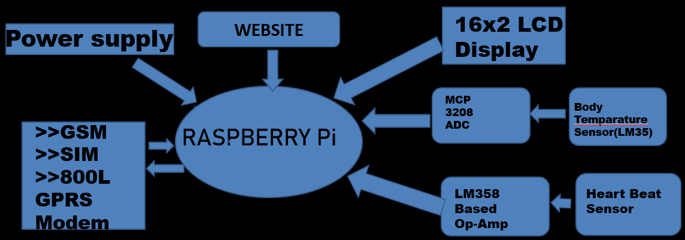
FLOW CHART

Slide 5
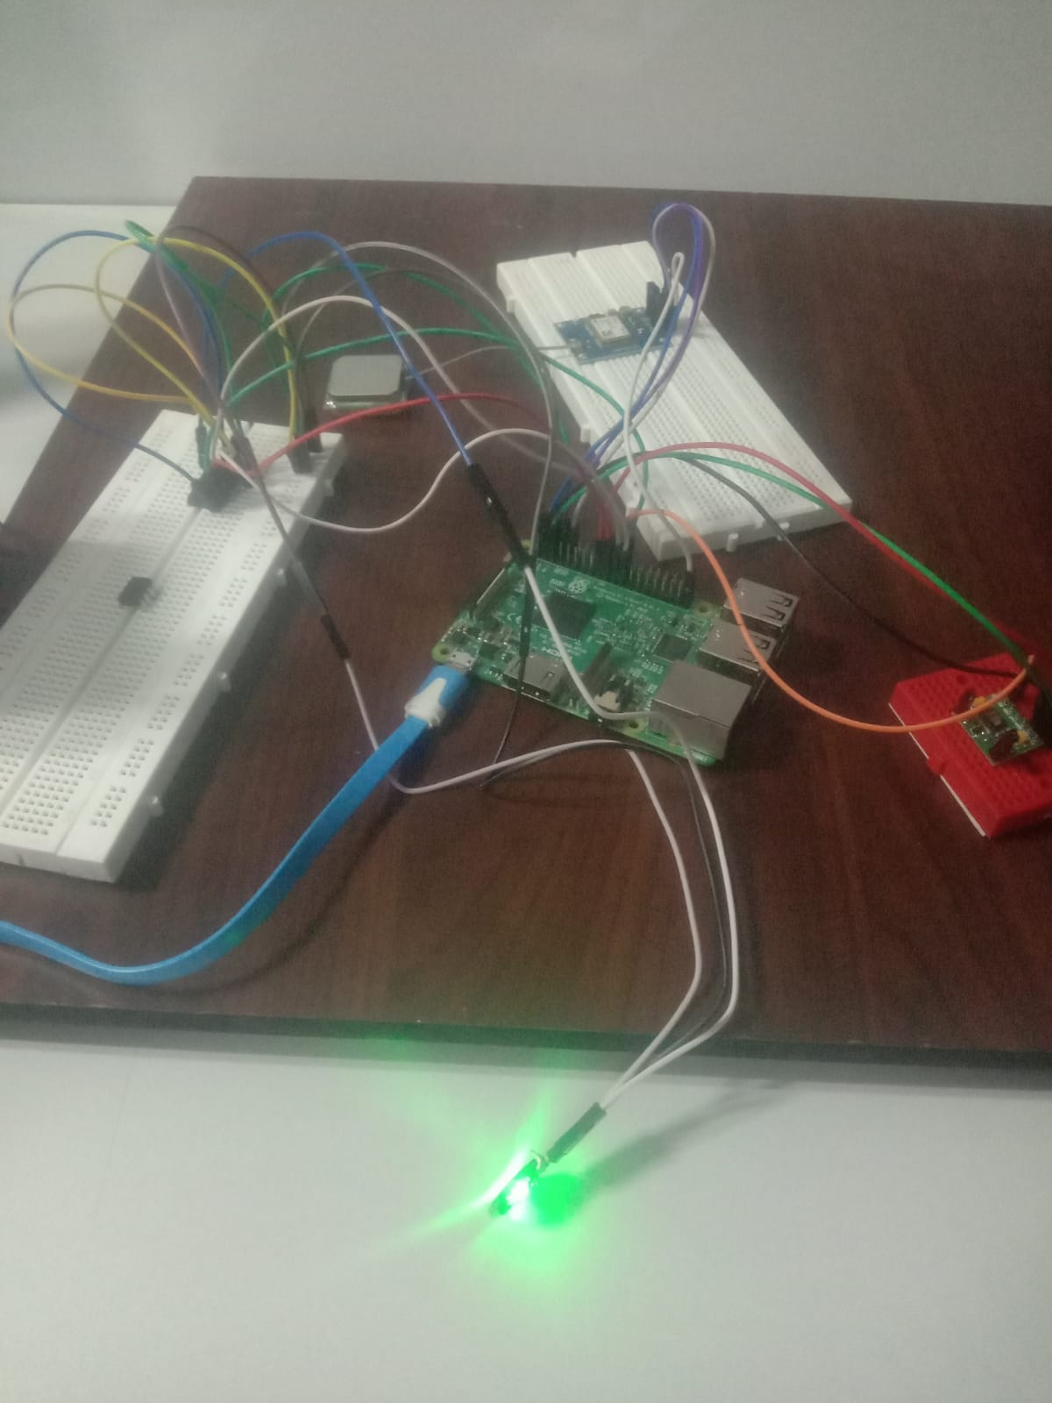

Slide 6
TEAM MEMBERS
SRIJIT B-23ECB43
SUNILKUMAR S-23ECB47
VINISH V-23ECB59
VISHNU RS-23ECB60

